Slide 1















Raster Input
Layer-wise SVG Reconstruction (5 paths in total)
Raster Input SVG Output Editing color Editing eyes

Slide 2
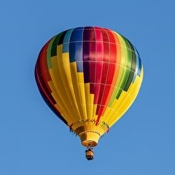





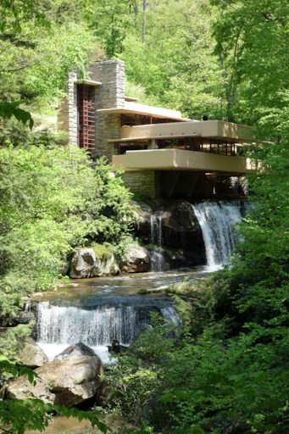
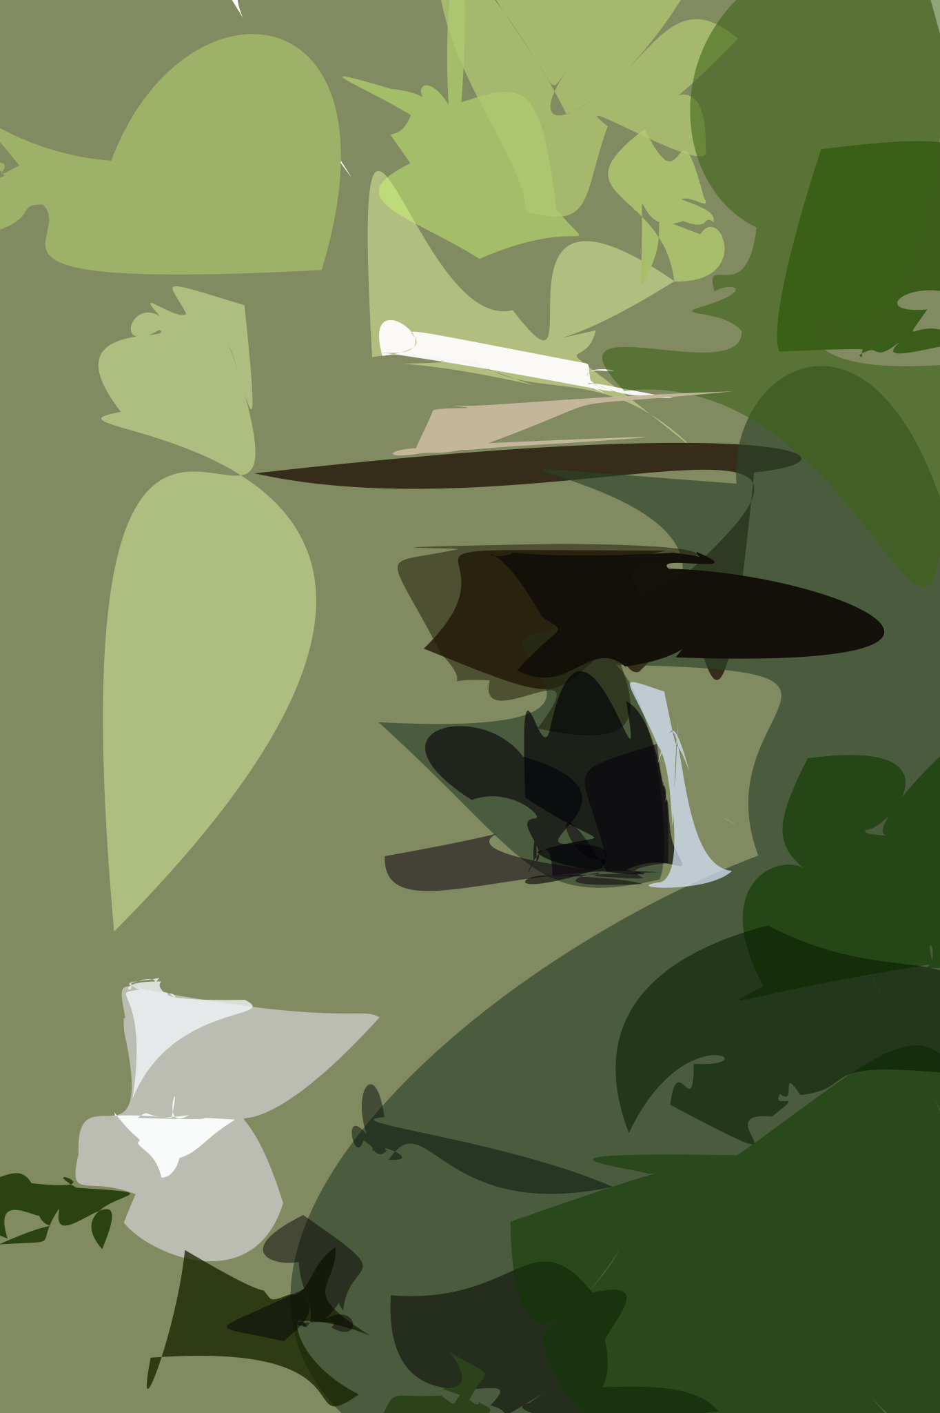
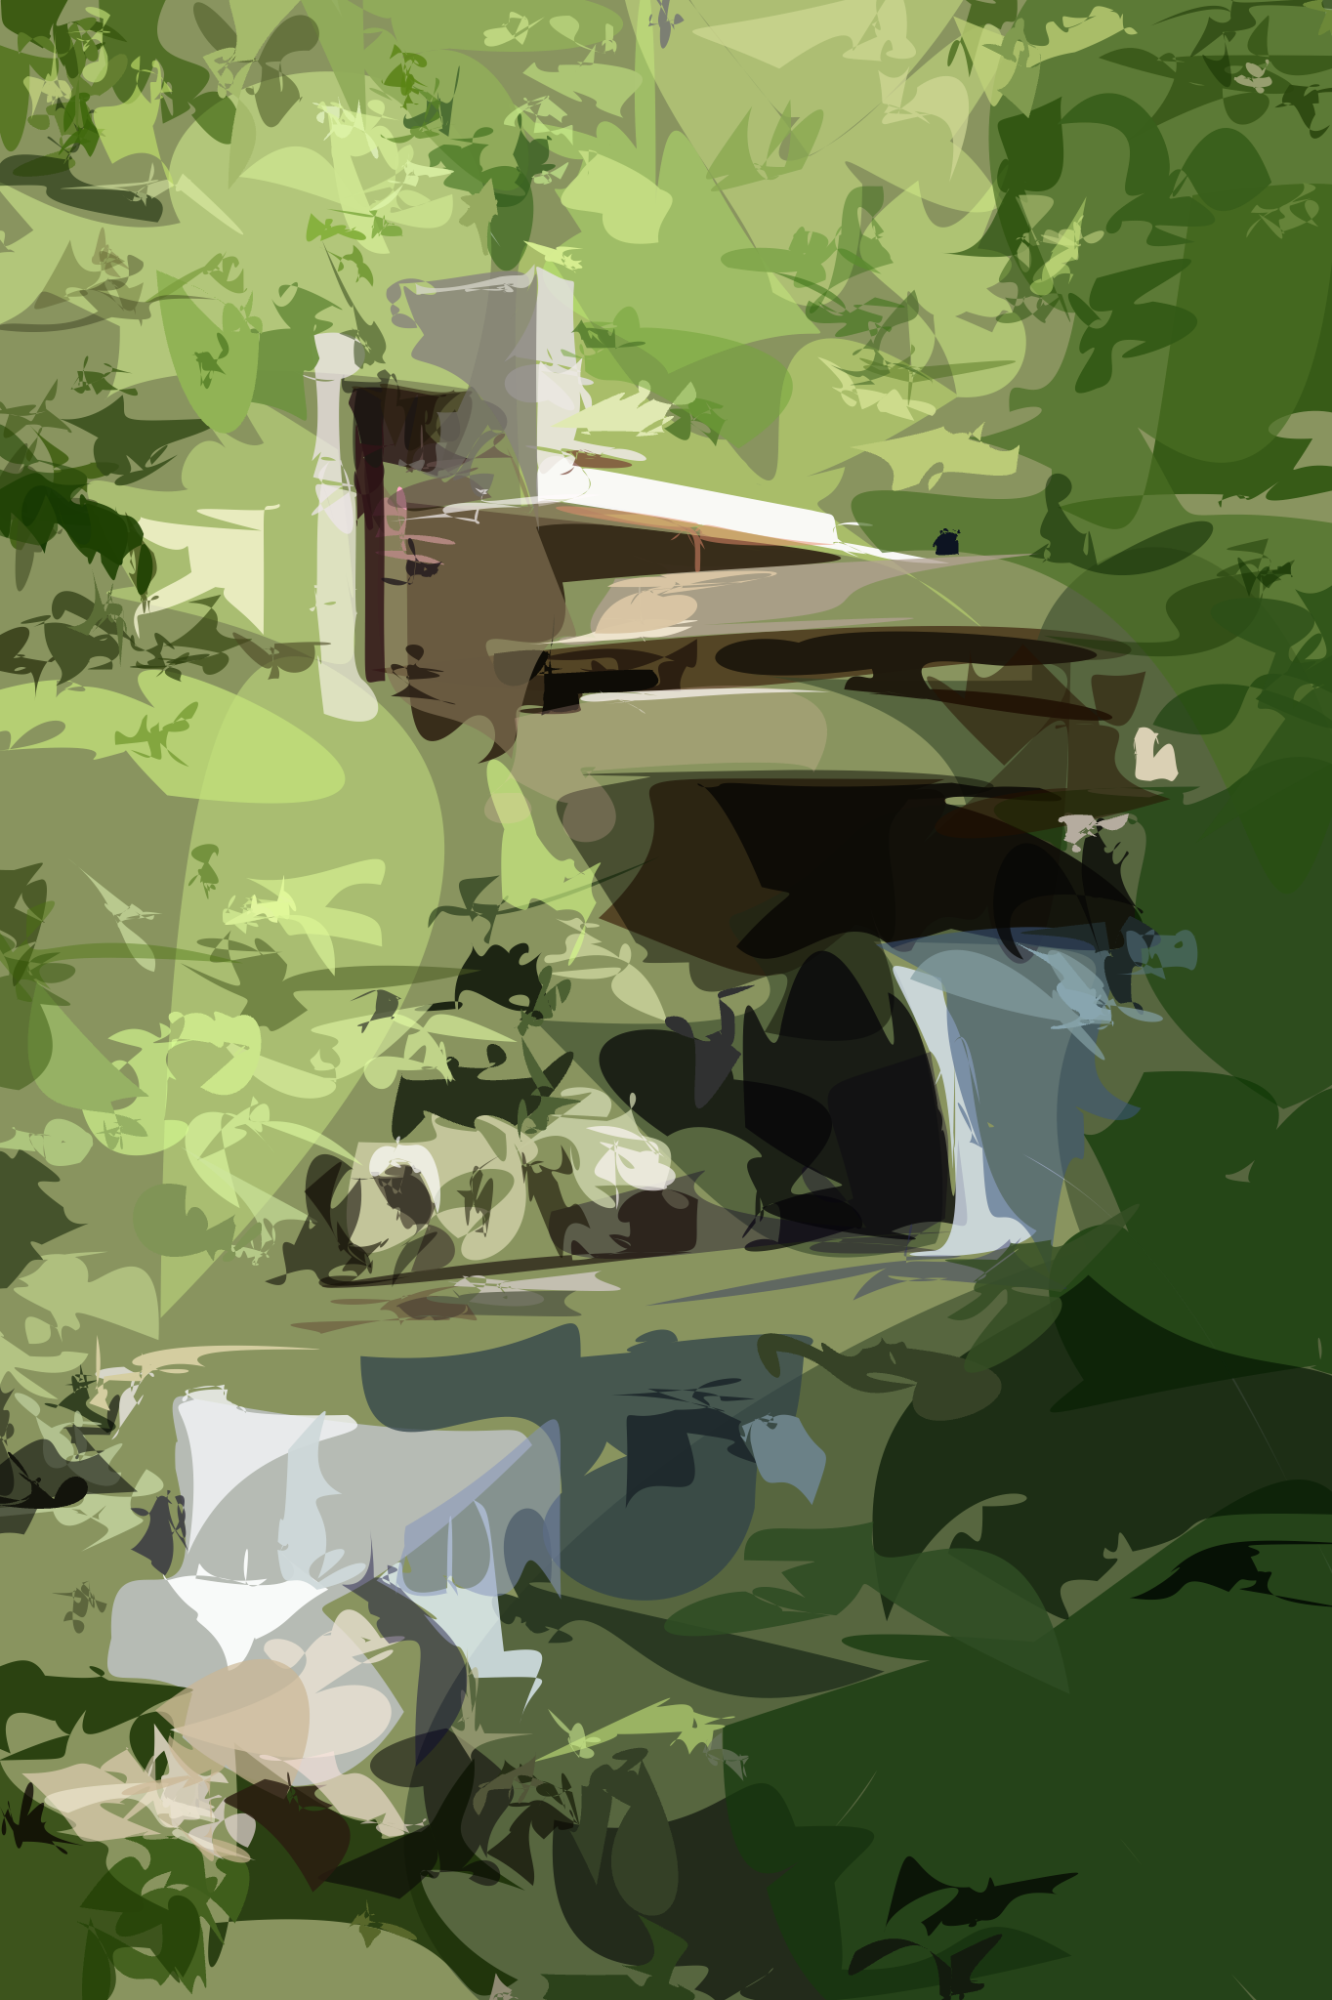
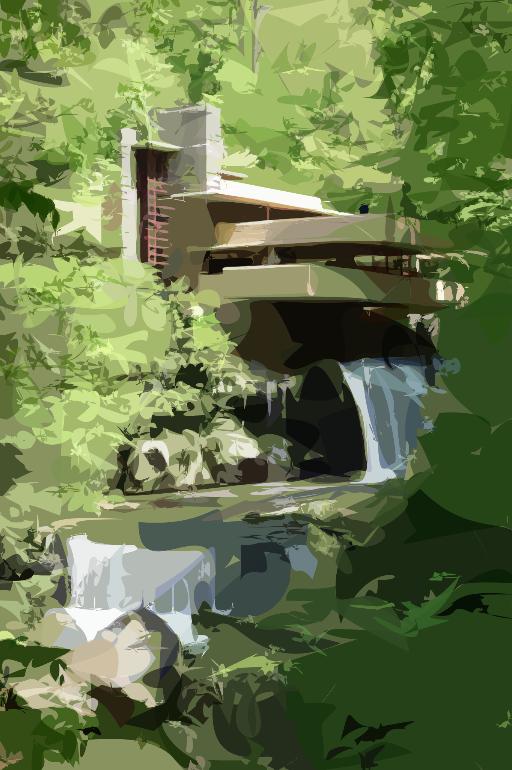
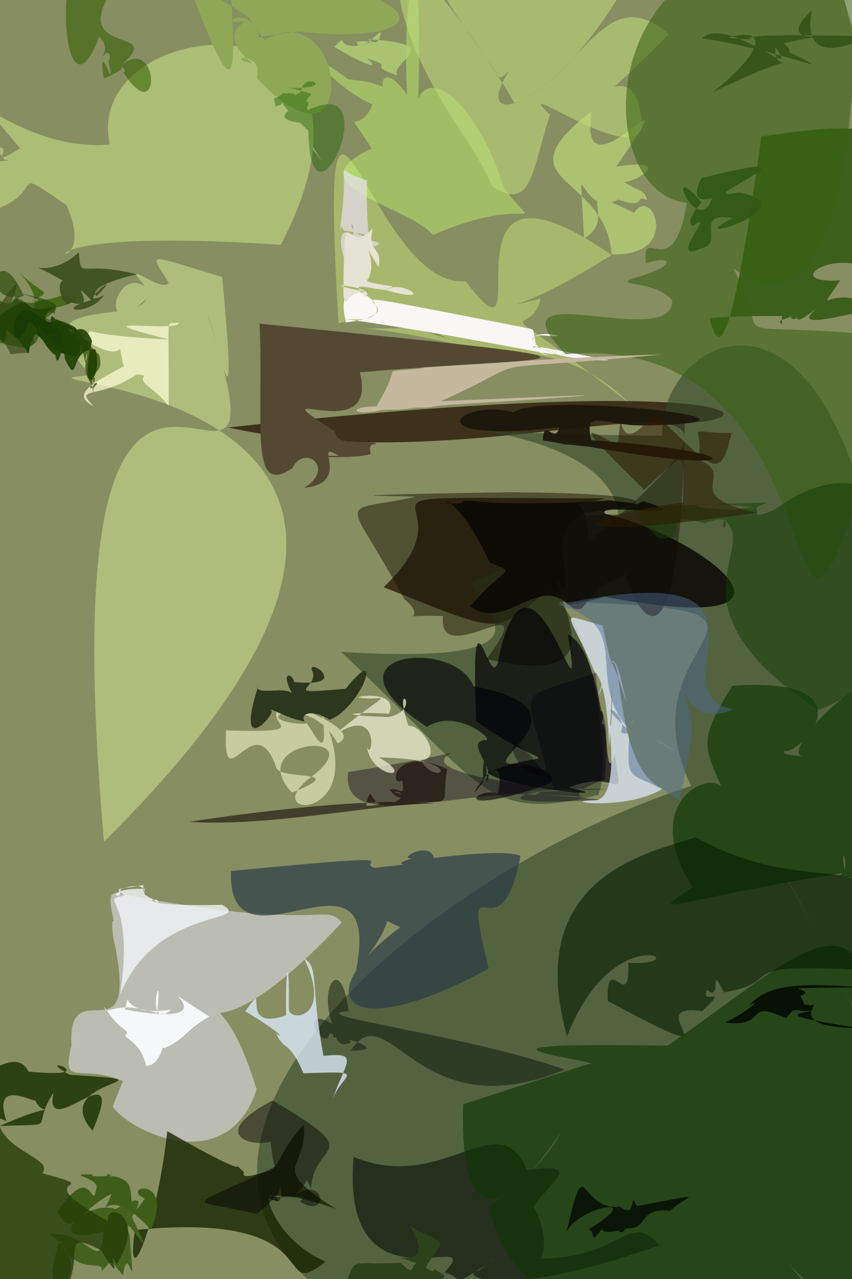
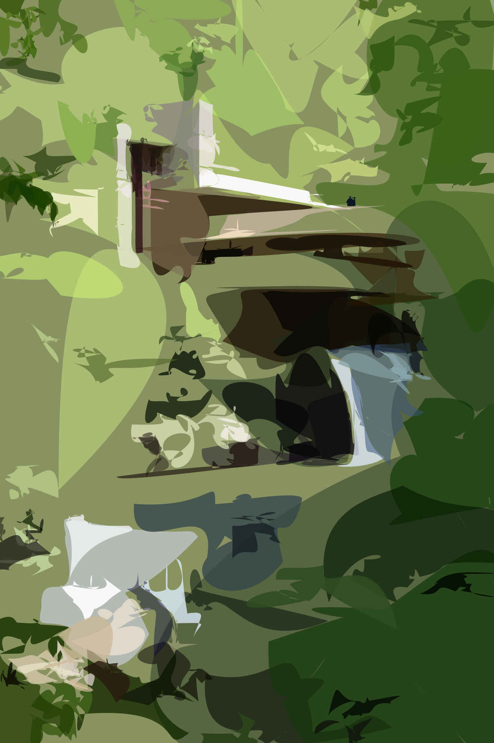
Raster Input
Layer-wise SVG Vectorization (from left to right)

Slide 3
N=10
N=20
N=30
N=40
N=50
Raster Input
N=32
N=64
N=128
N=256
N=512
Layer-wise Image Vectorization (from left to right)

Slide 4


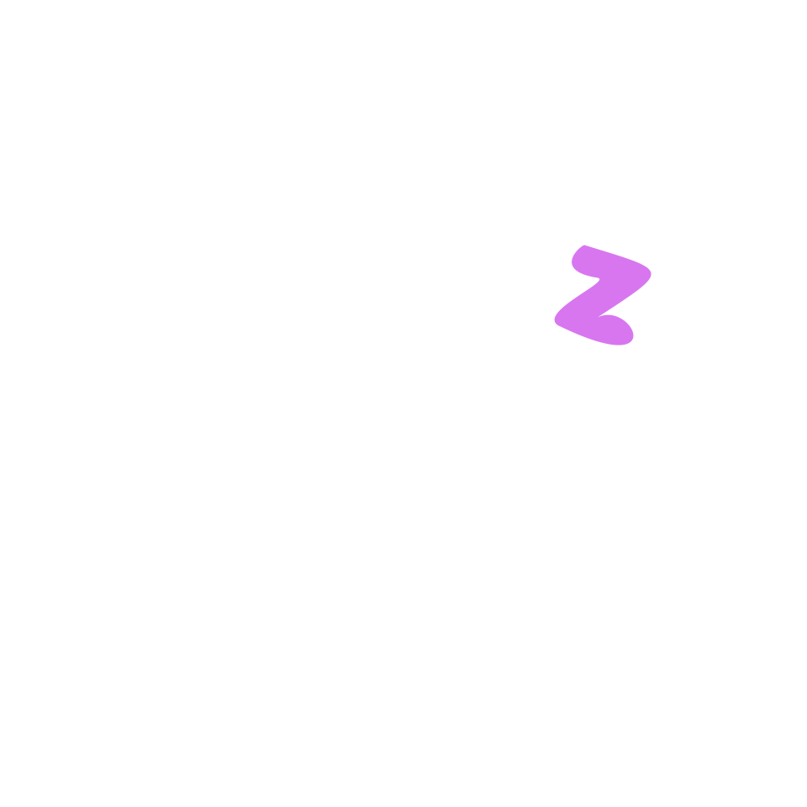






Slide 5







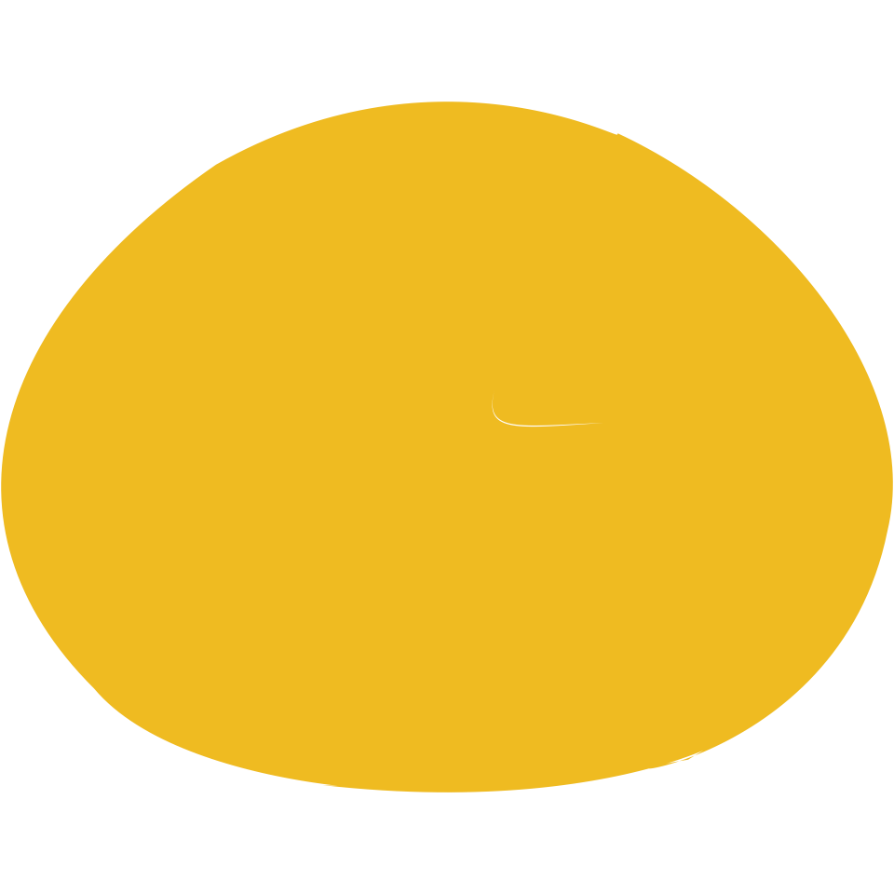








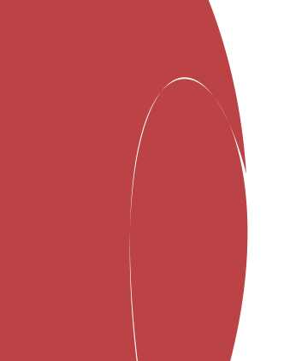
Circle Initialization
Random Initialization

Slide 6







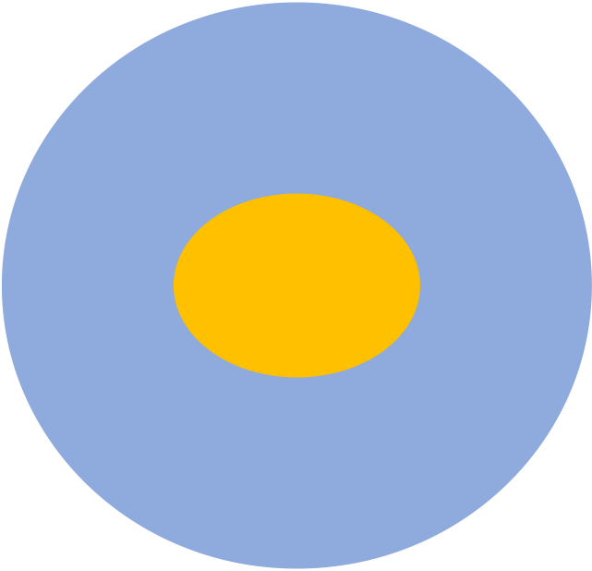

RGB(244,196,72)
RGB(225,179,83)
RGB(244,197,87)
RGB(93,134,194)
RGB(108,126,152)
RGB(86,132,194)
Target
MSE-Loss
UD-Loss
Target
MSE-Loss
UDF-Loss
RGB (93,134,194)
RGB (86,132,194)
SDF loss

Slide 7









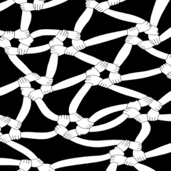

Emoji
Pics

Slide 8





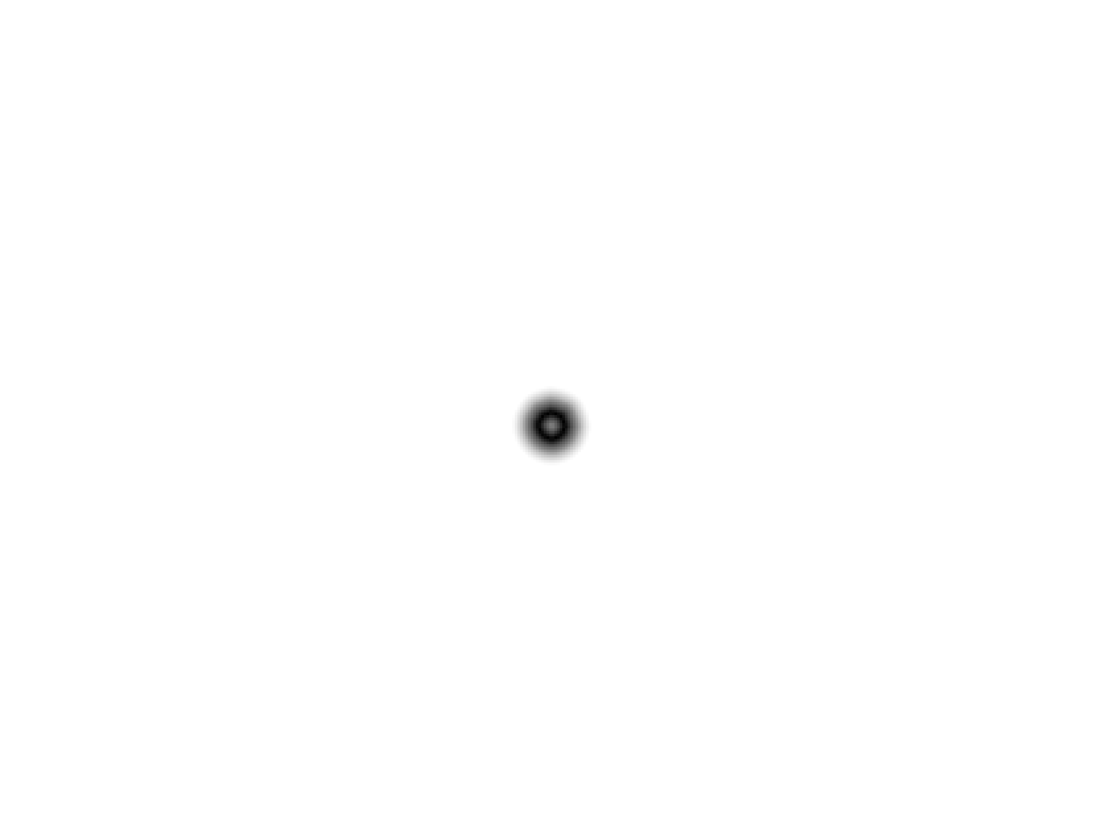
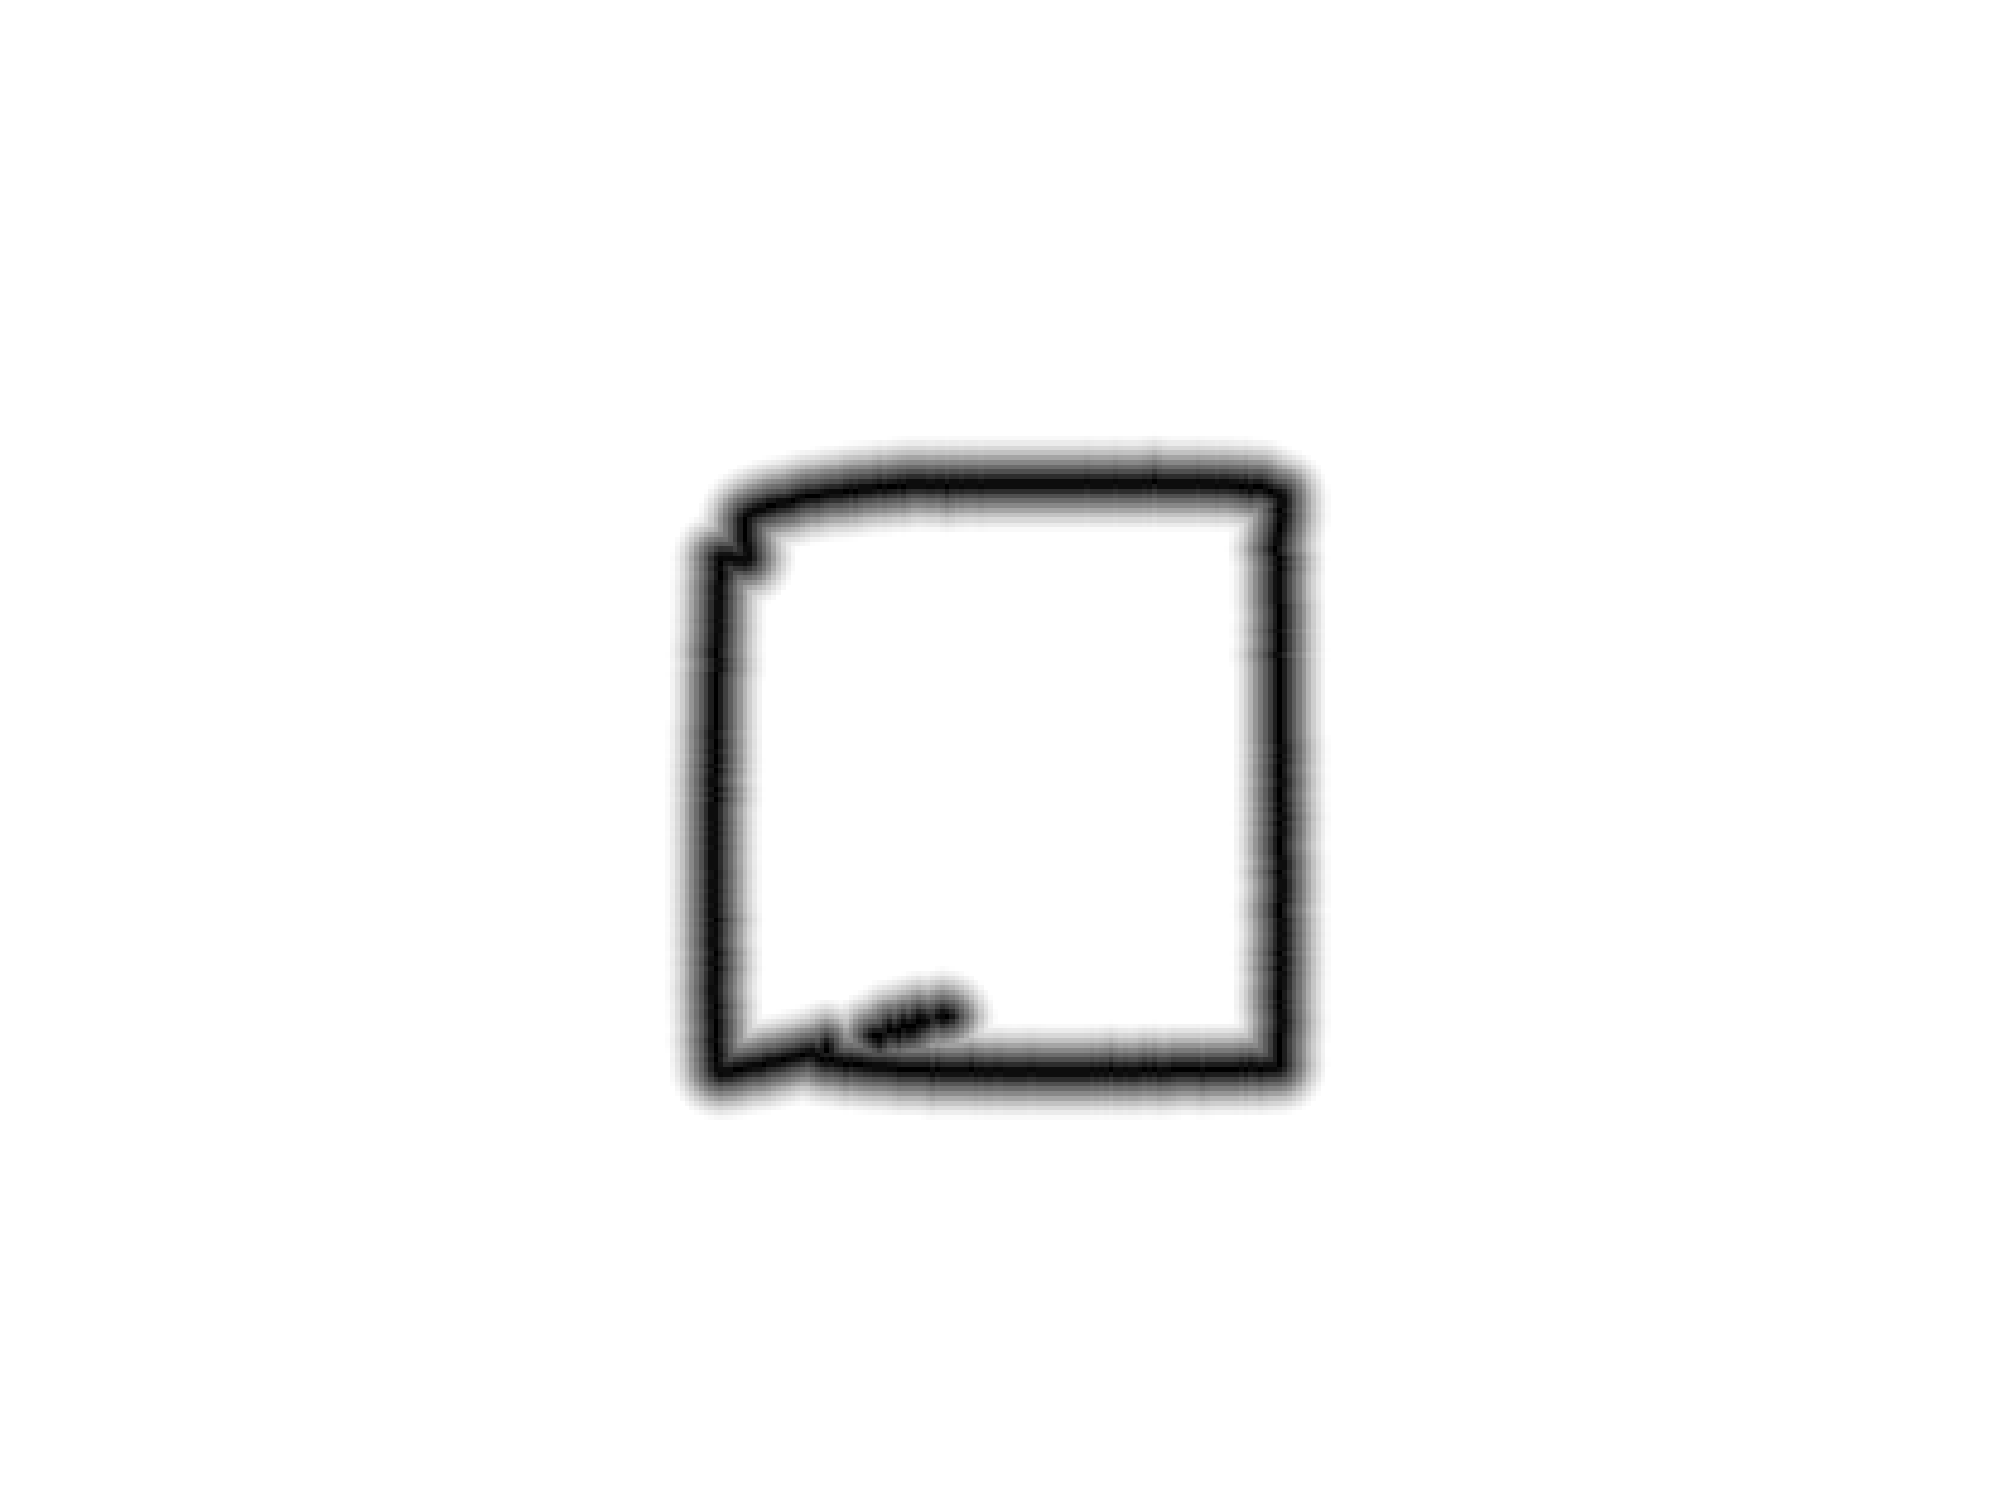
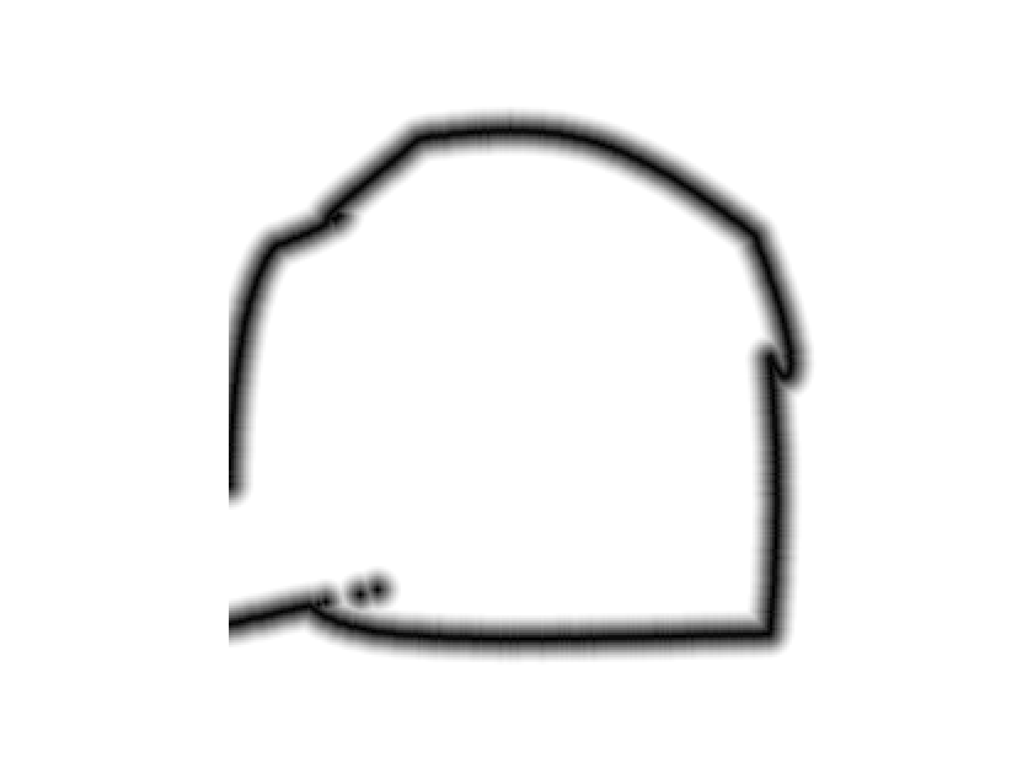
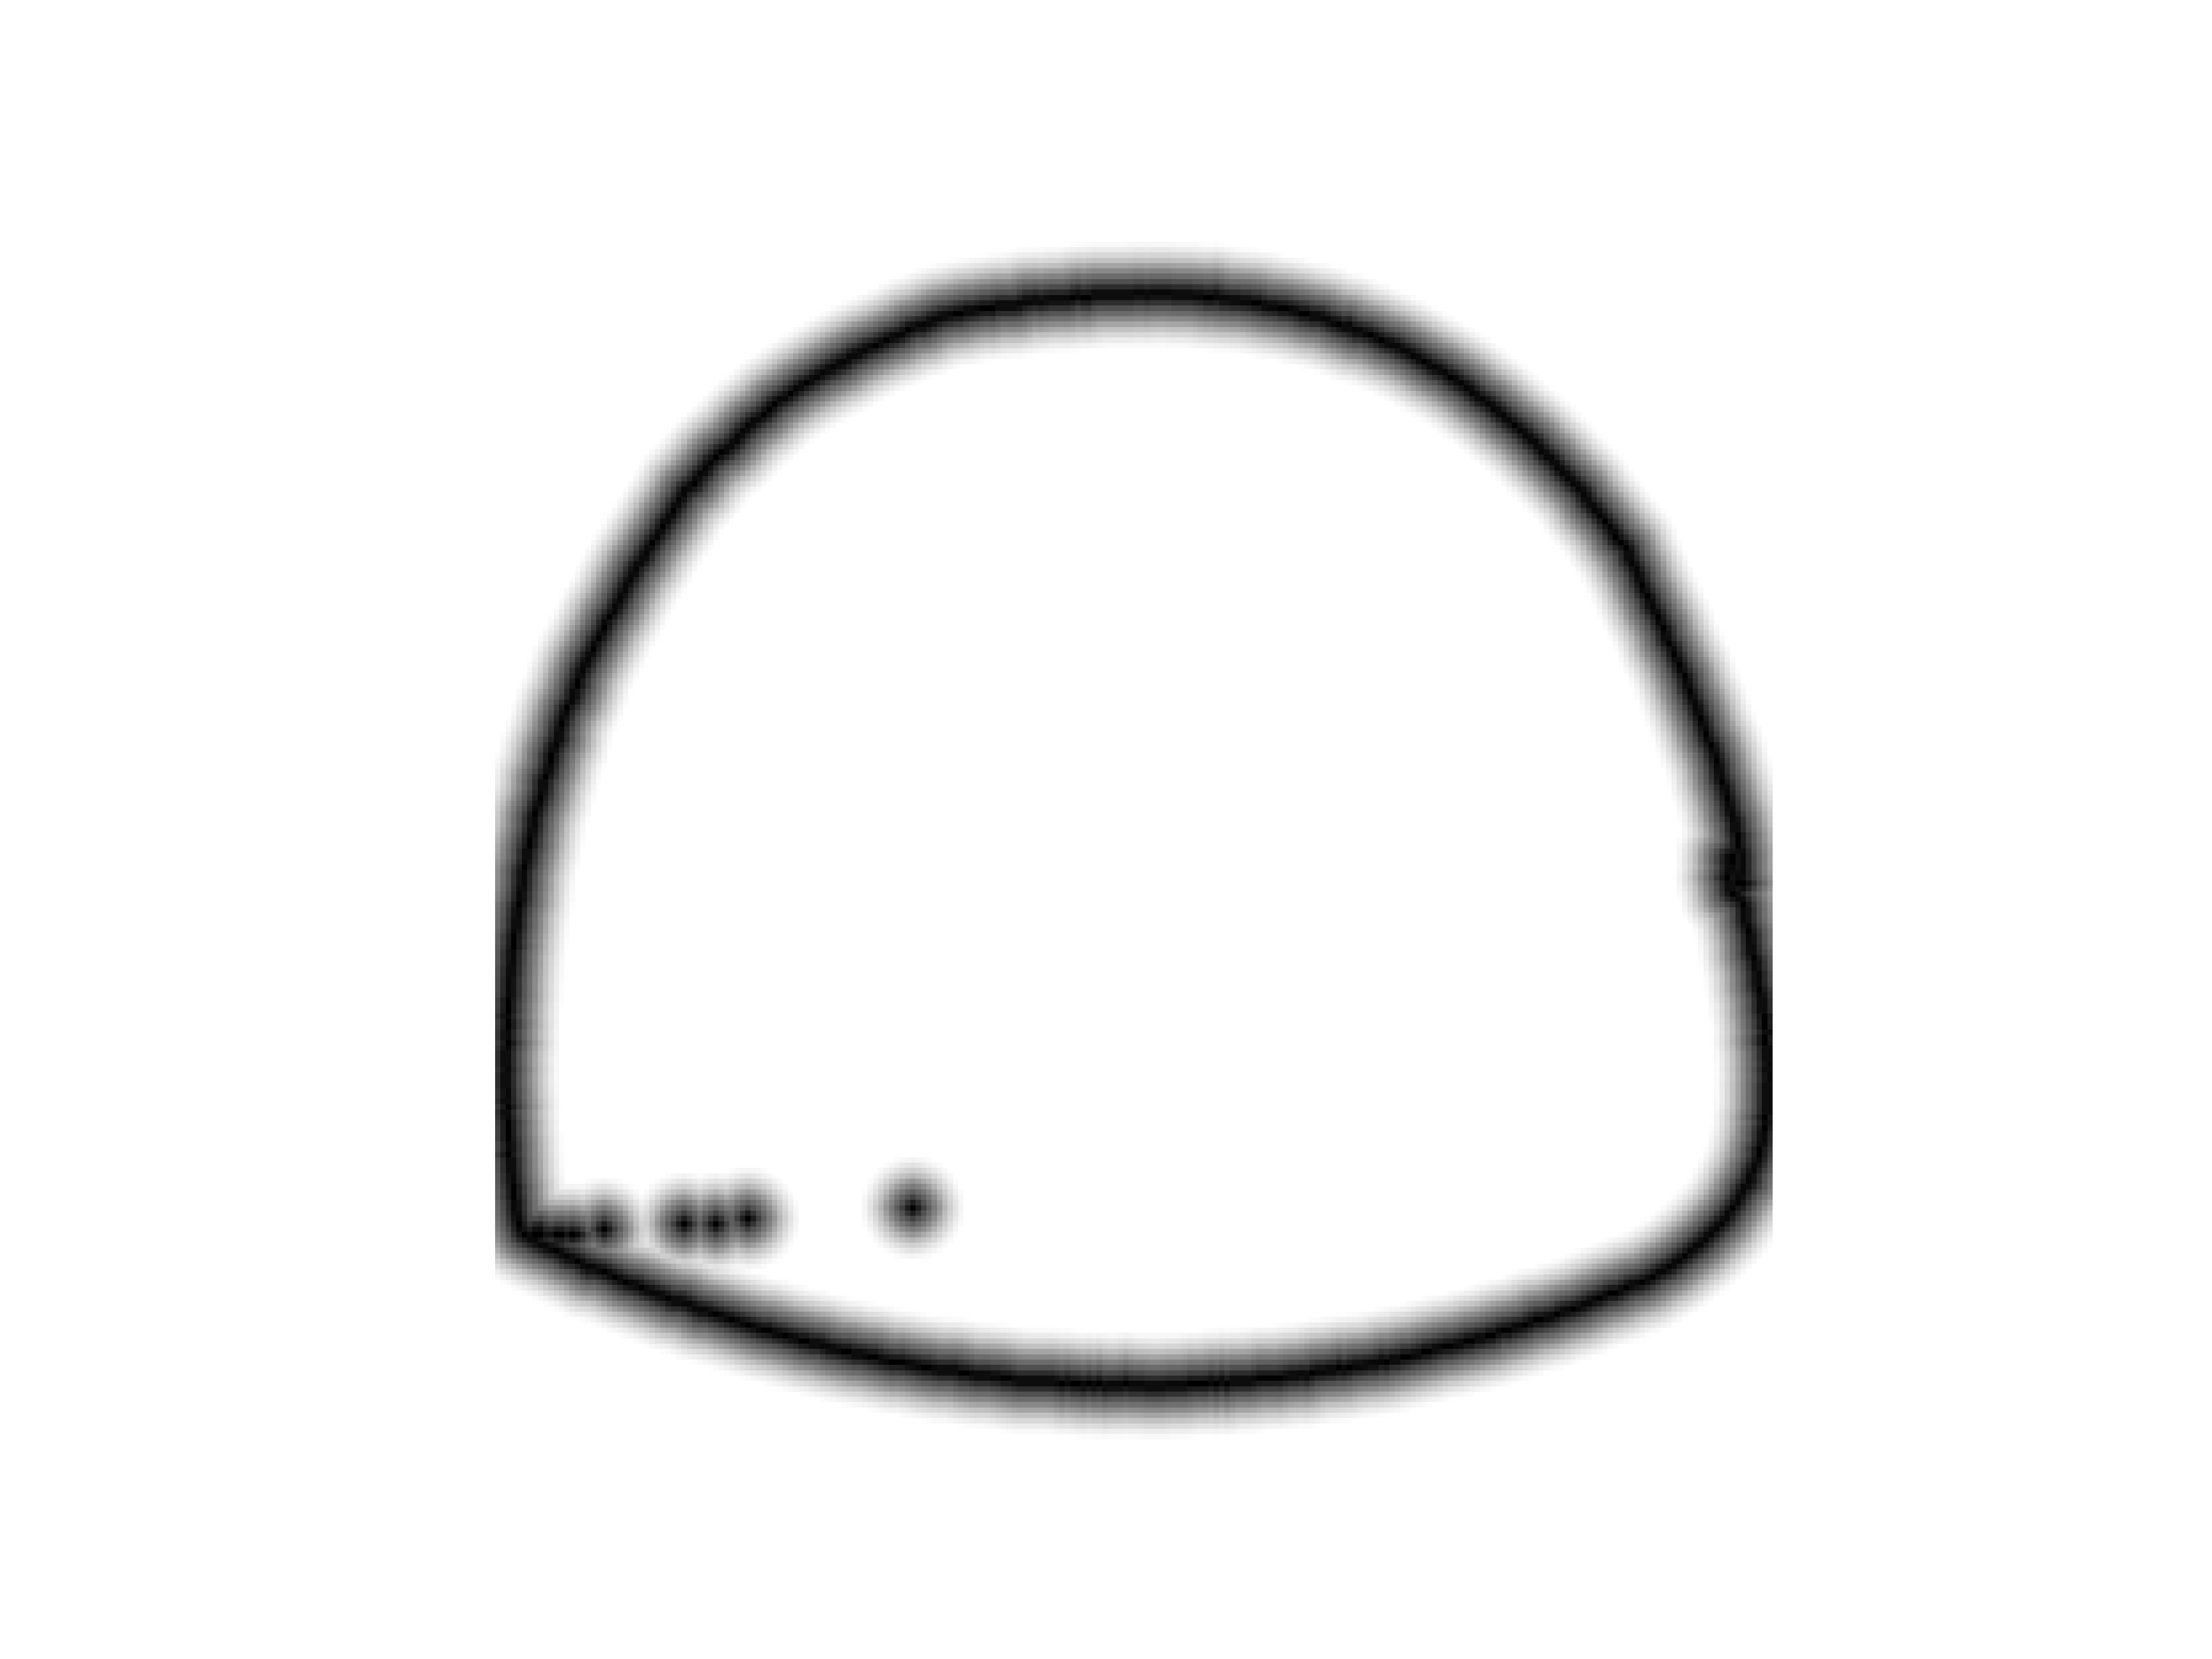
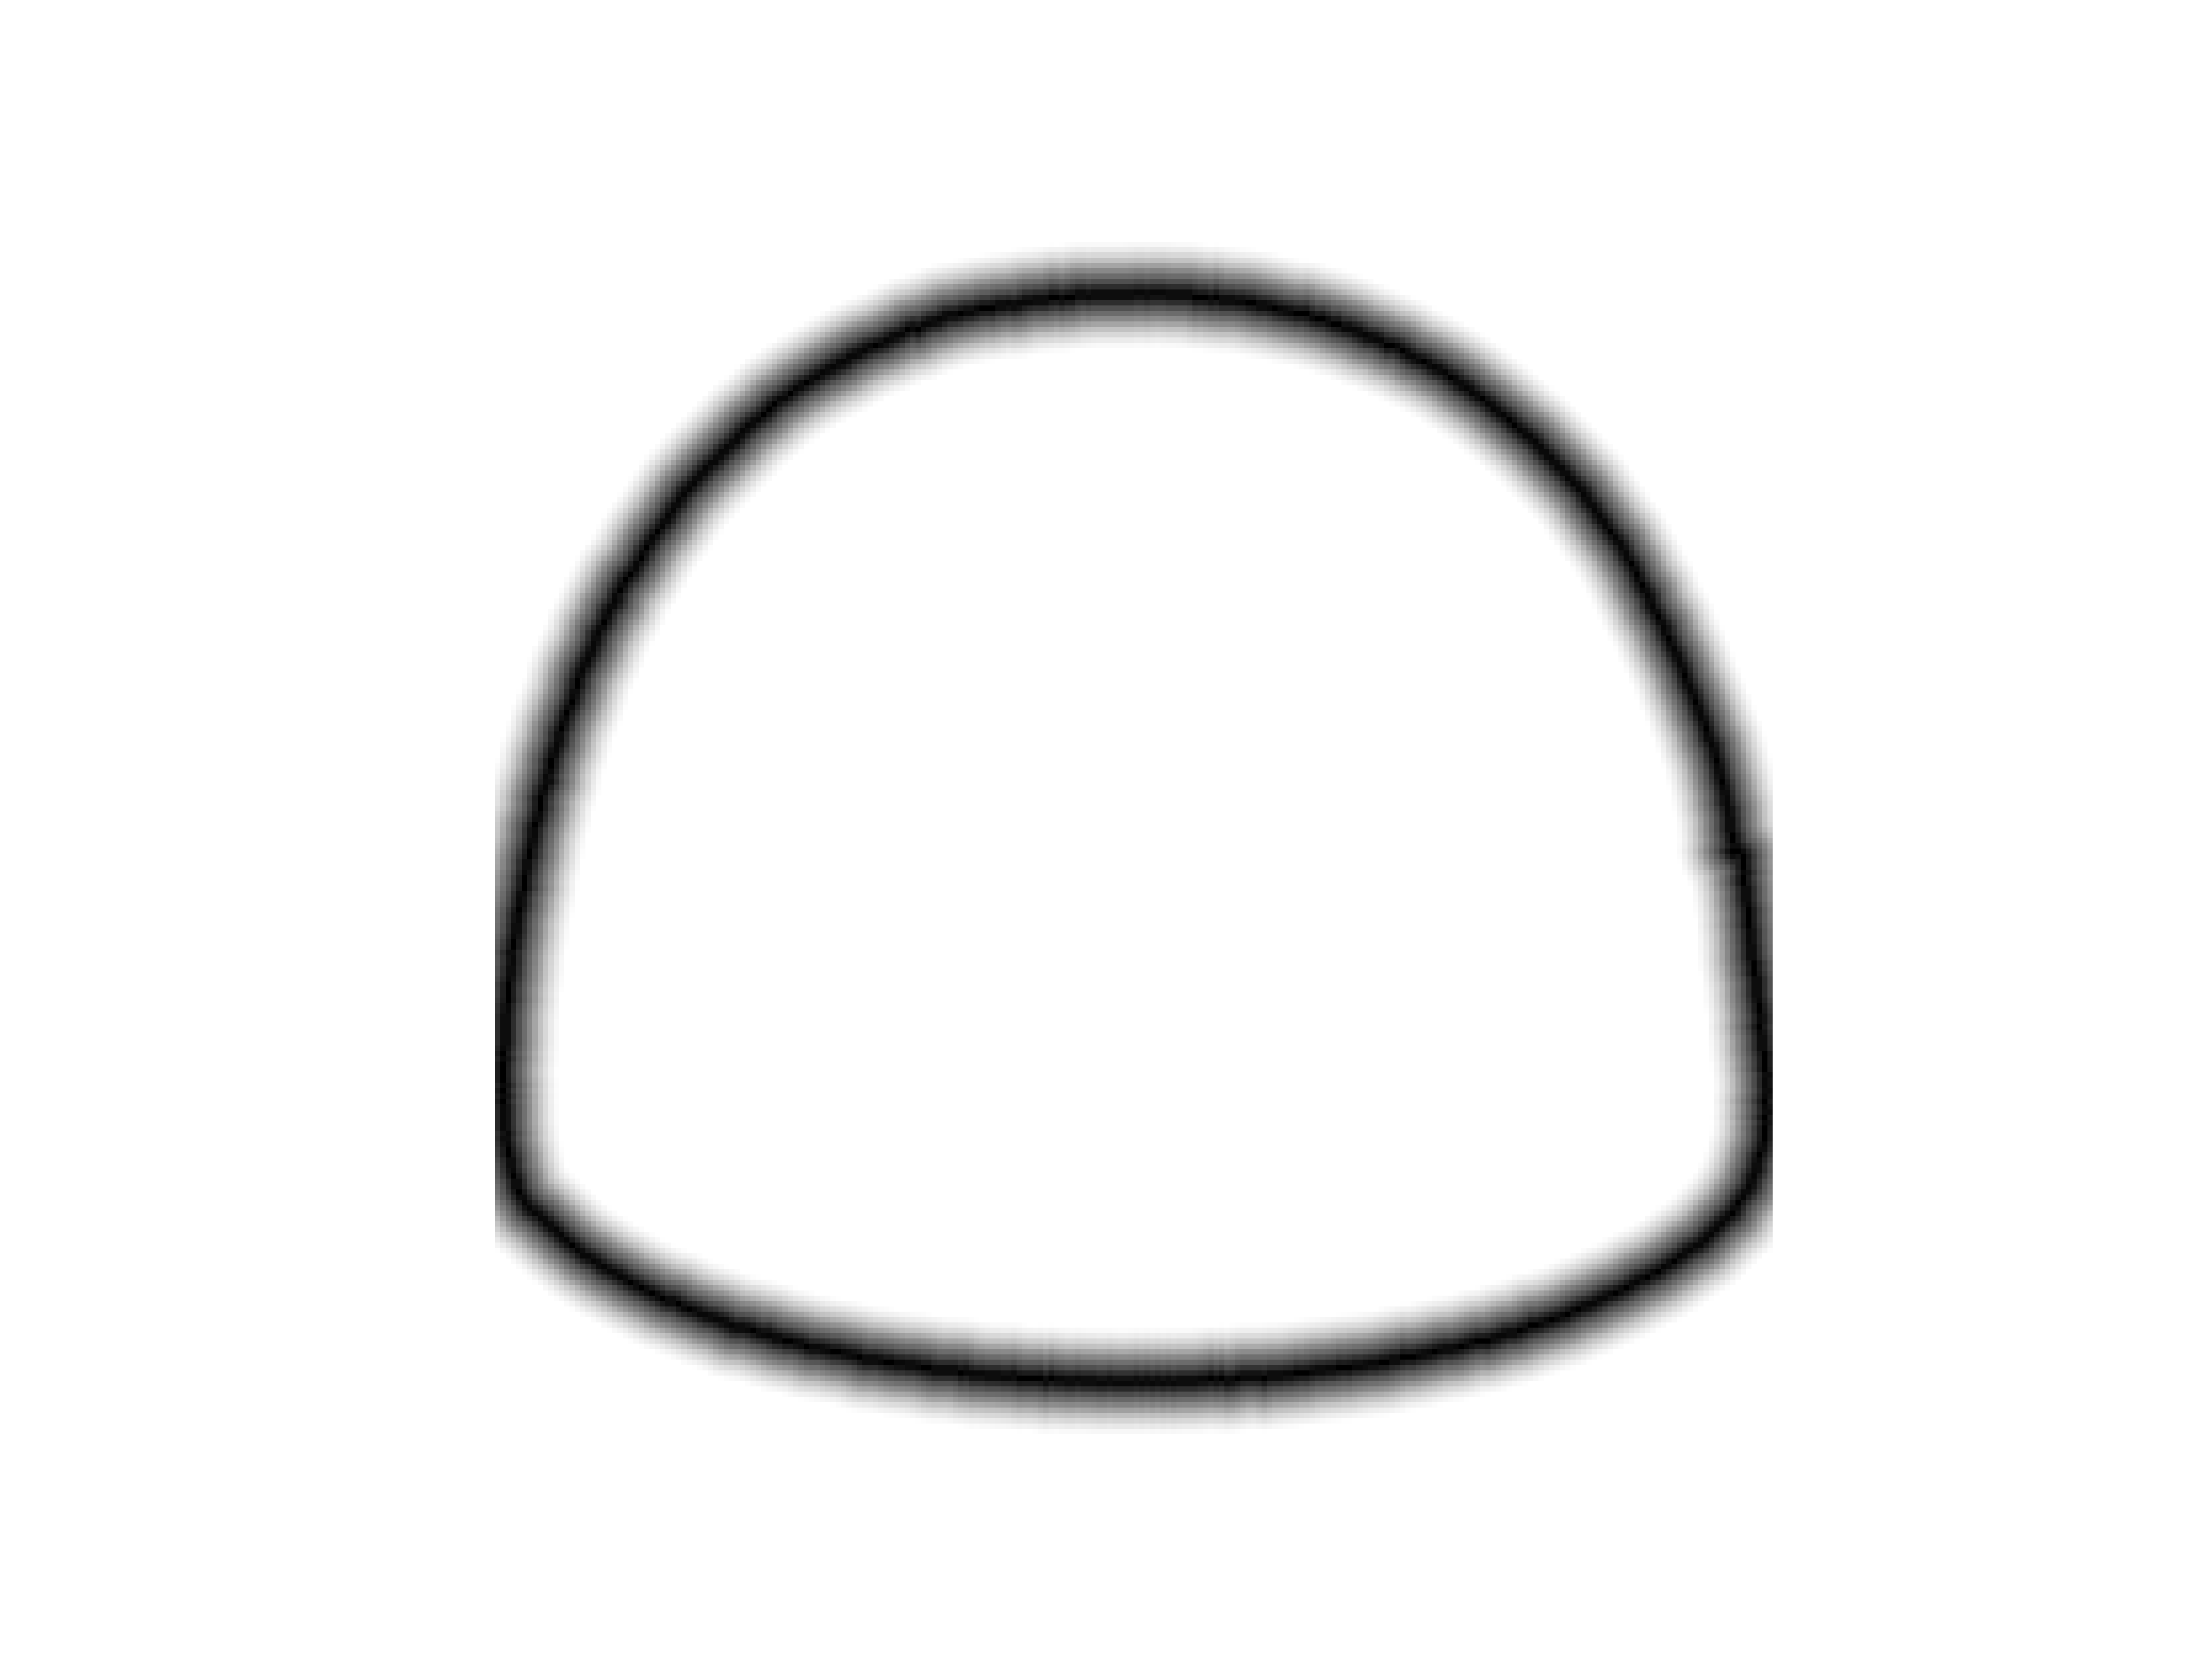
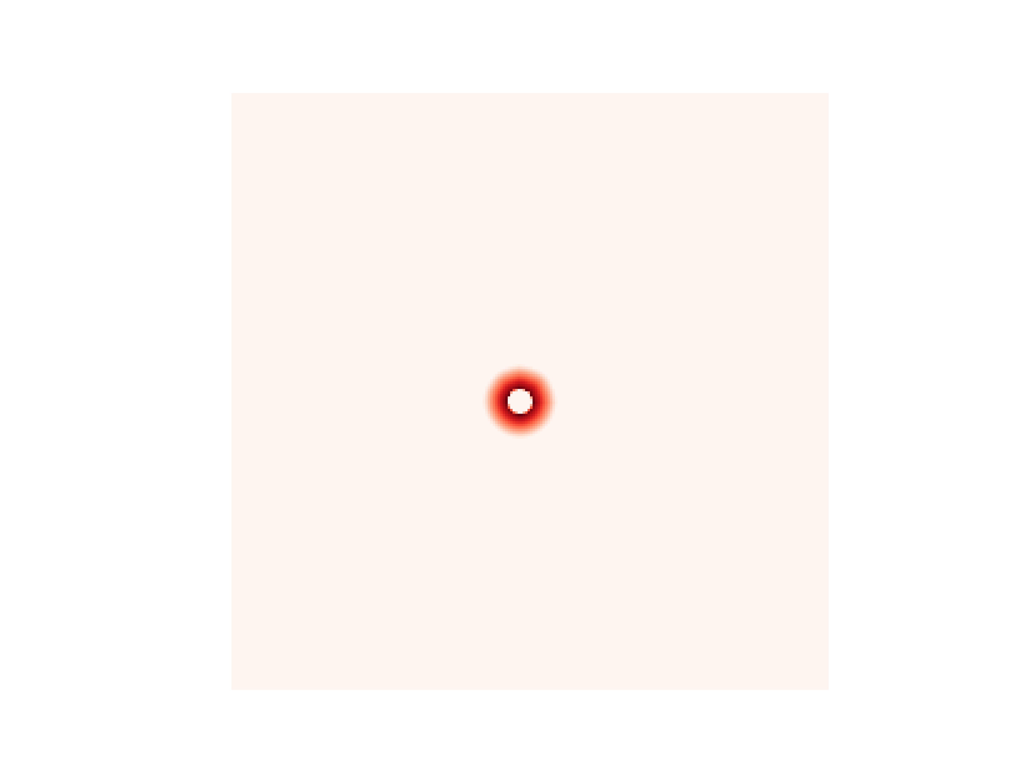
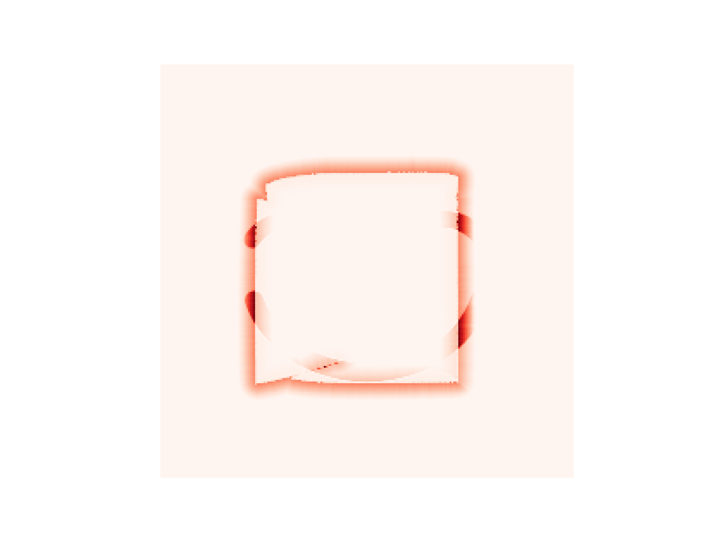
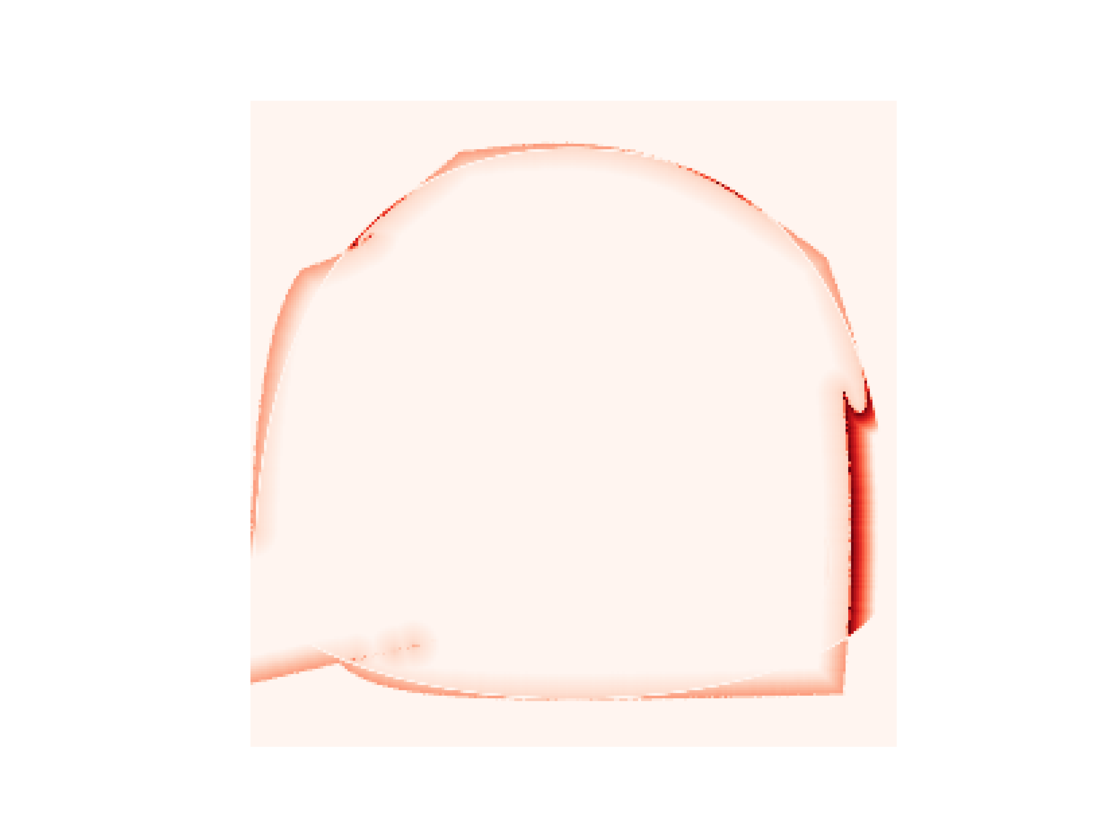
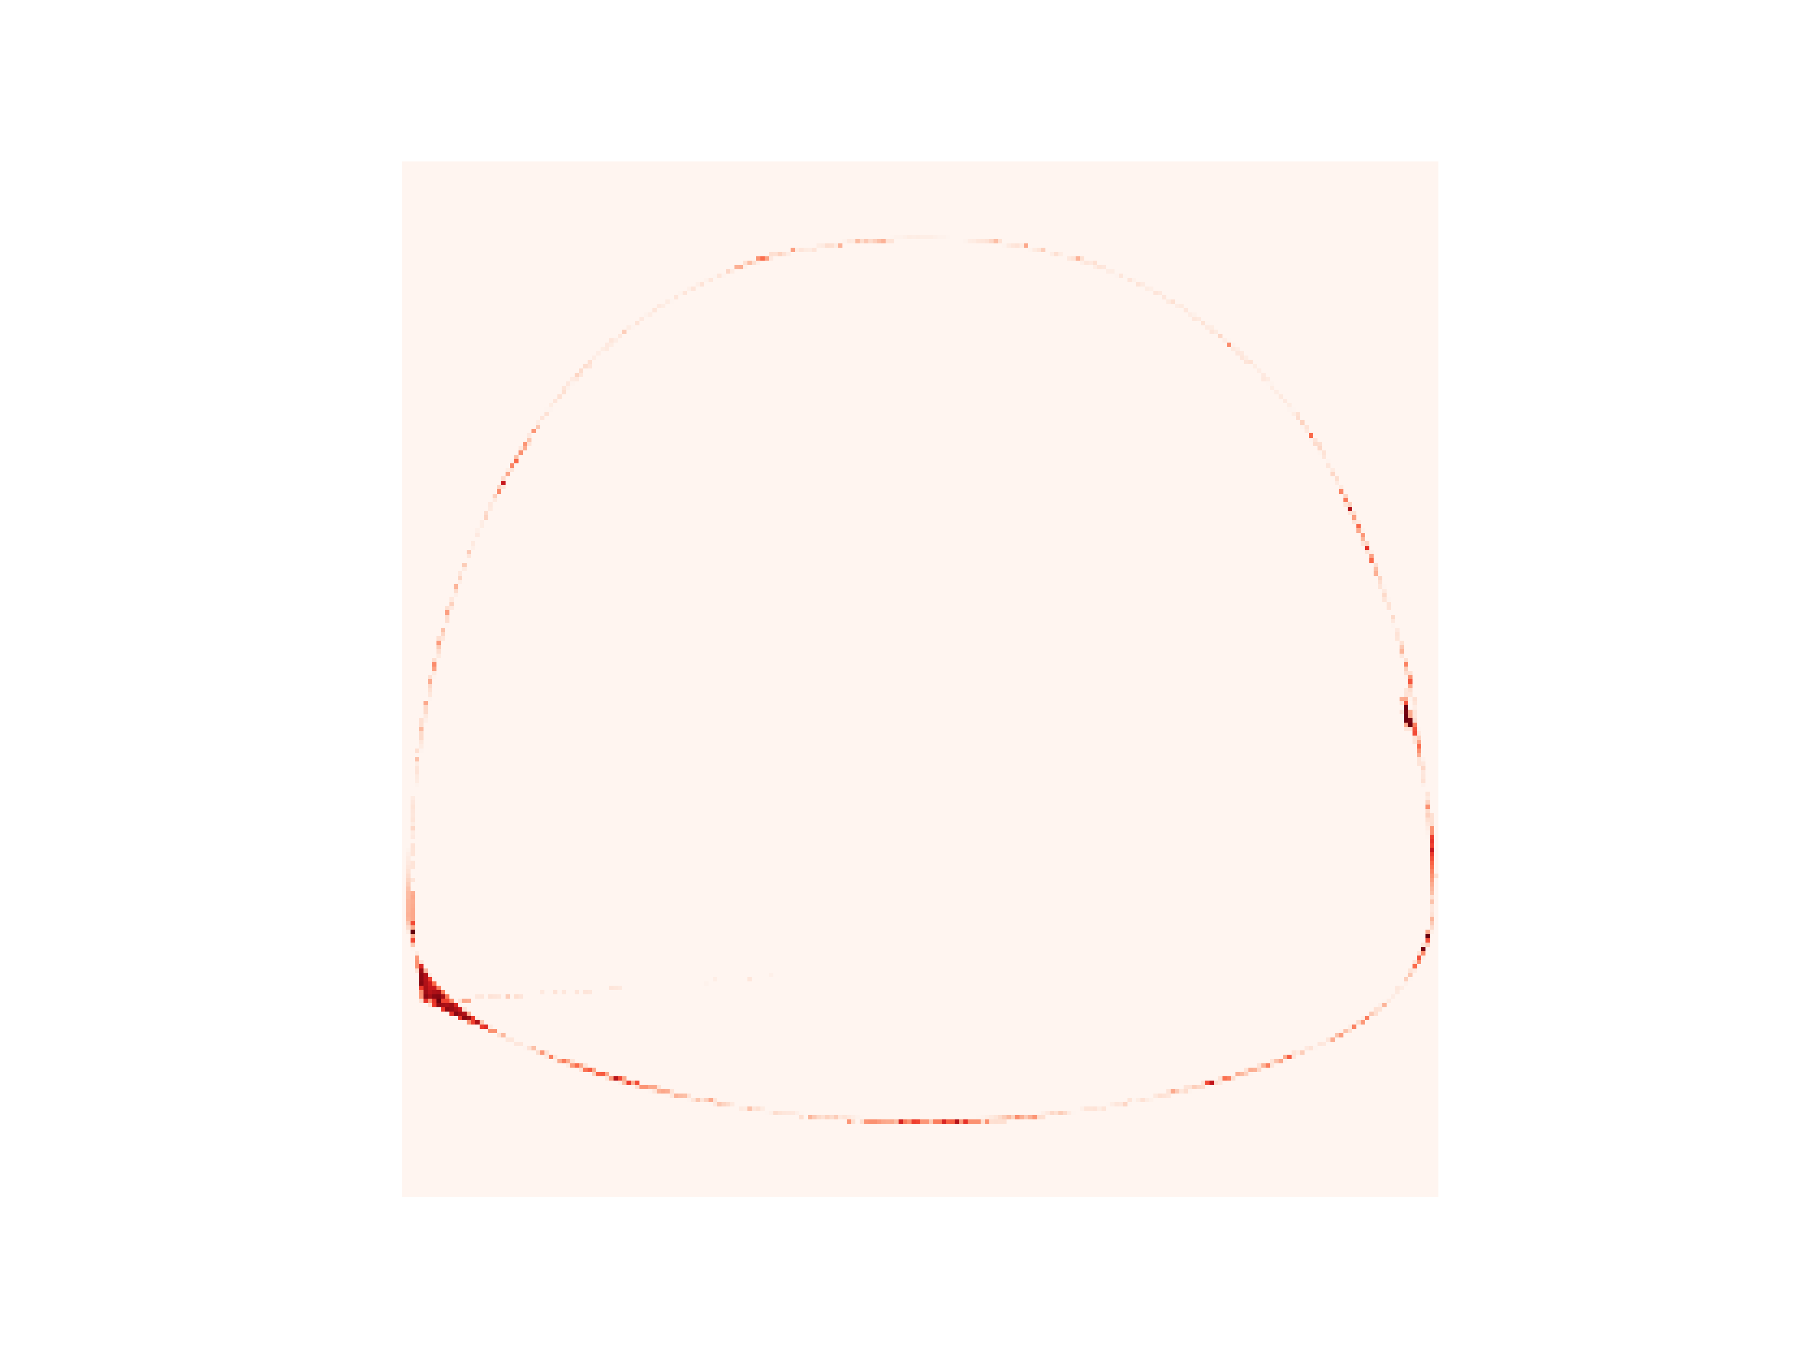
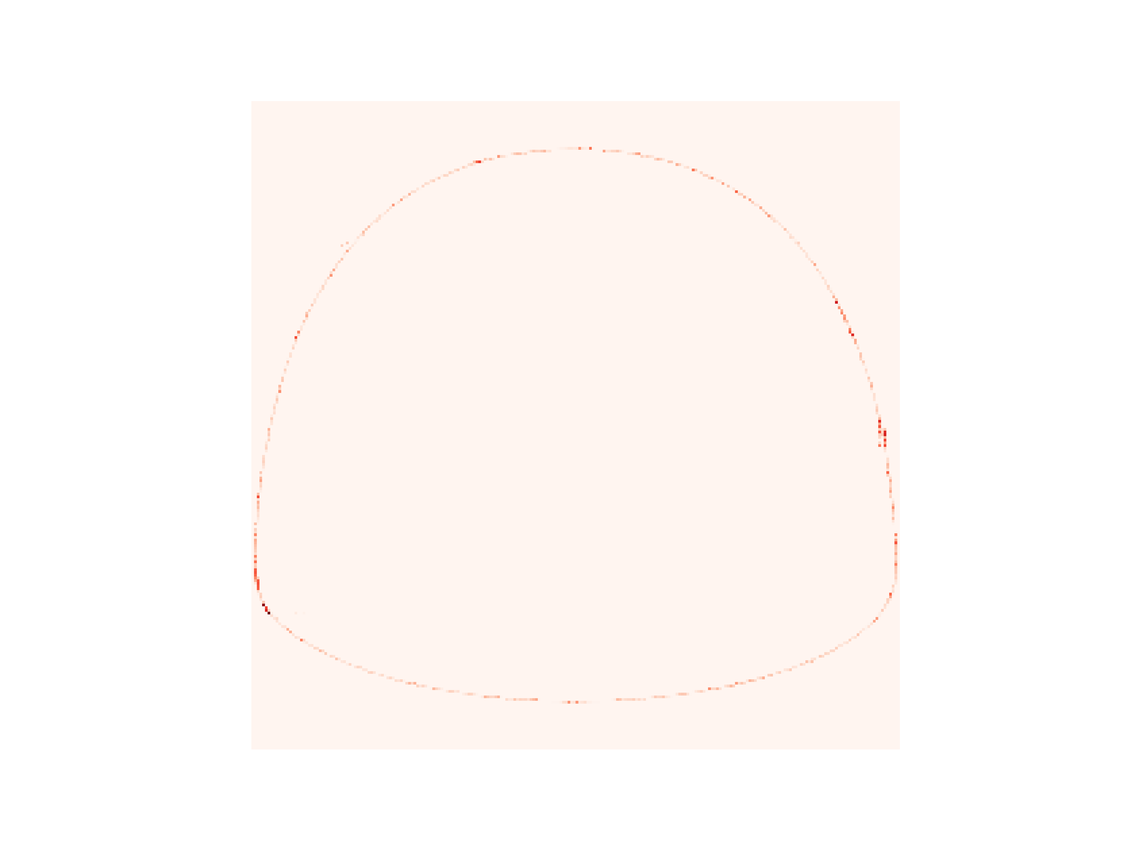
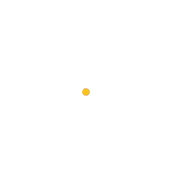
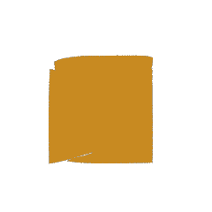
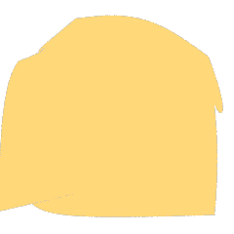
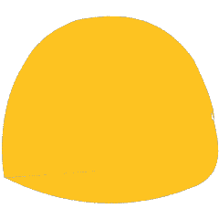
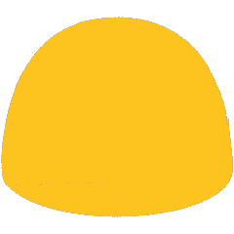
MSE loss
UD weight
UD loss
Shape
Iter. 1
Iter. 50
Iter. 100
Iter. 150
Iter. 200

Slide 9
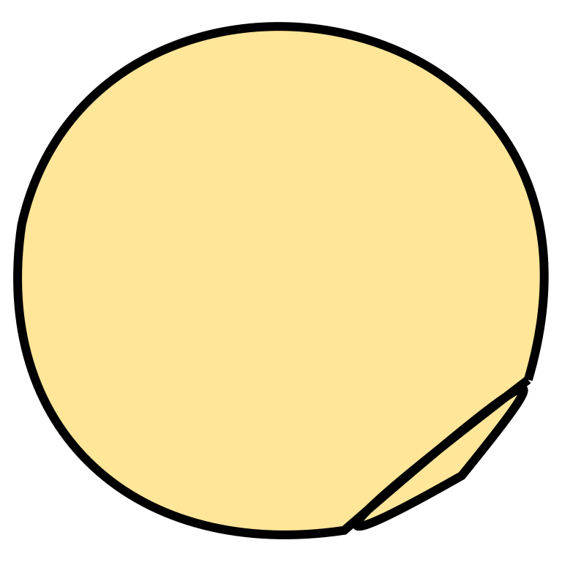
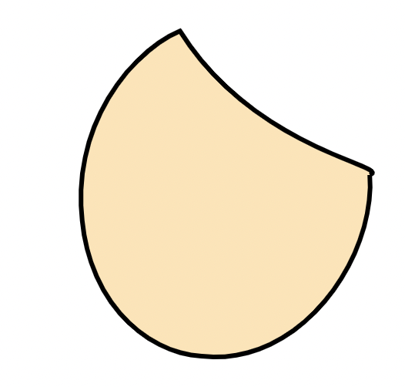
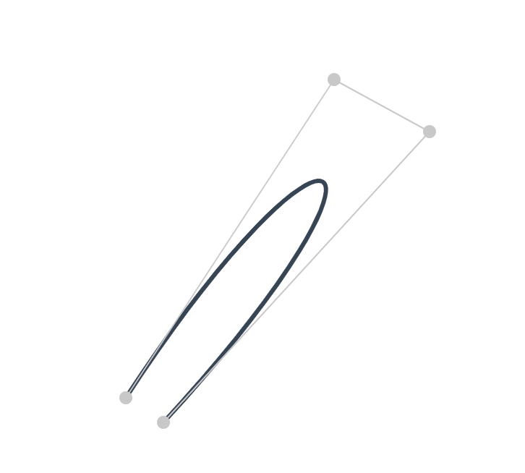
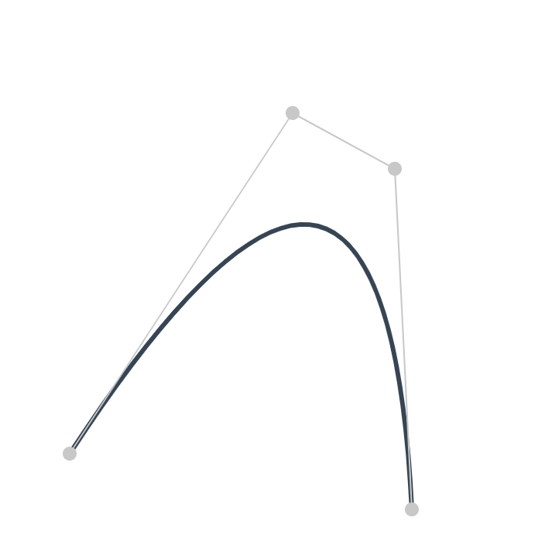


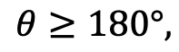
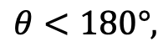
B
B
$$θ$$
C
$$θ$$
C
A
$$θ<180°,$$
A
$$θ≥180°,$$
D
Prone to self-interaction.
D
Prone to convex.

Slide 10
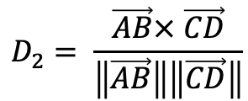
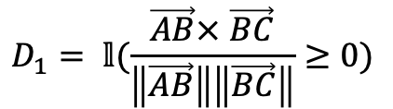



X-ing Loss to avoid self-intersection
B
B
$$θ$$
C
$$θ$$
C
$$\sin{θ}$$
$$D_{1}= 𝕝(\frac{\vec{AB}× \vec{BC}}{\left\|\vec{AB}\right\|\left\|\vec{BC}\right\|}≥0)$$
$$D_{2}= \frac{\vec{AB}× \vec{CD}}{\left\|\vec{AB}\right\|\left\|\vec{CD}\right\|}$$
A
D
A
$$ℒ=D_{1}\left(ReLU\left(−D2\right)\right)+(1−D1)(ReLU\left(D2\right))$$
D

Slide 11






































































LIVE
DiffVG
LIVE
DiffVG
LIVE
DiffVG
LIVE
DiffVG
Raster Input
SVG out (from 1 to 8 paths)

Slide 12
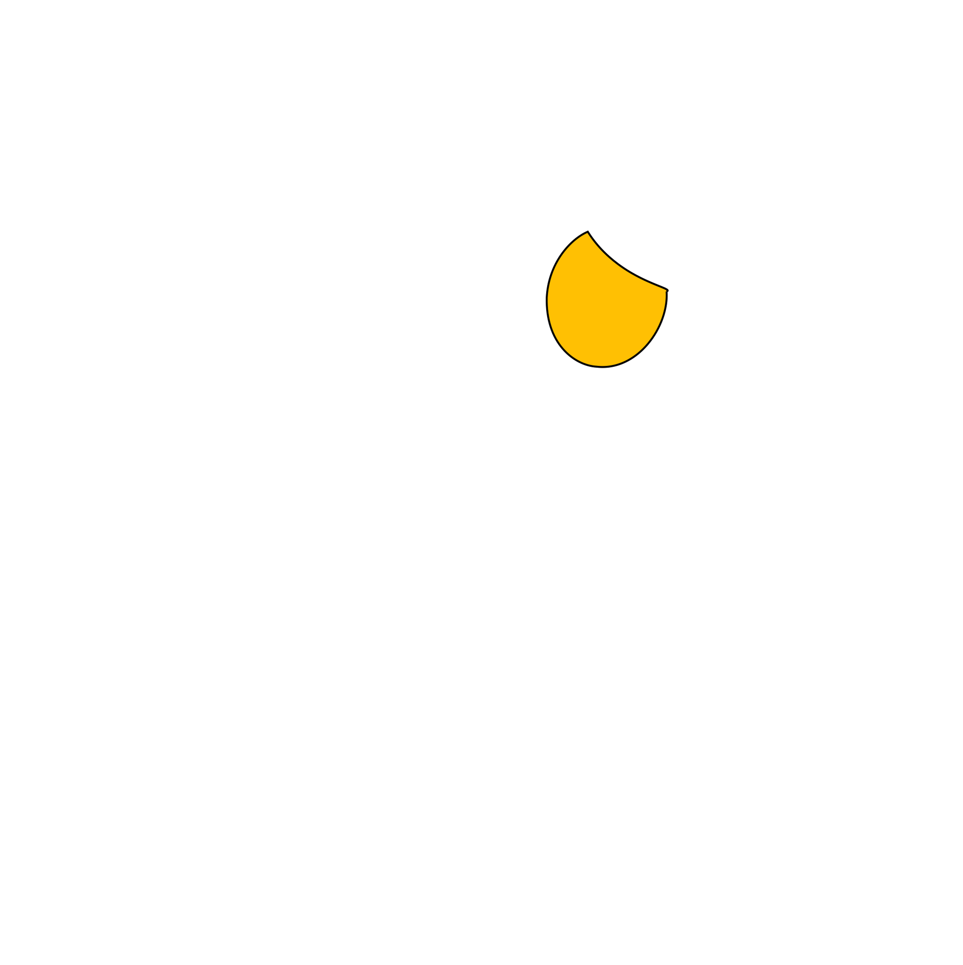


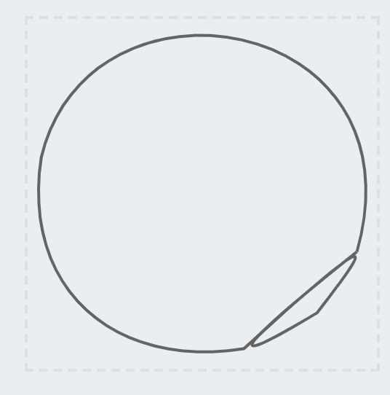
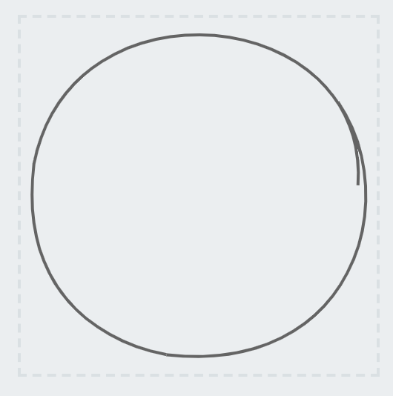

Slide 13
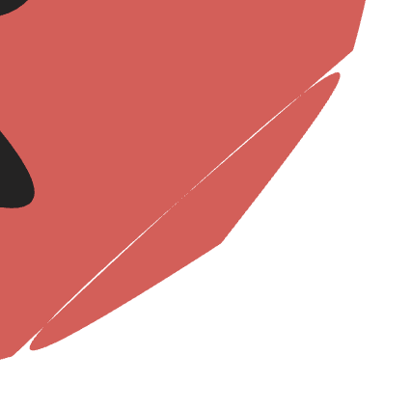

Without Xing loss
With Xing loss

Slide 14



Slide 15













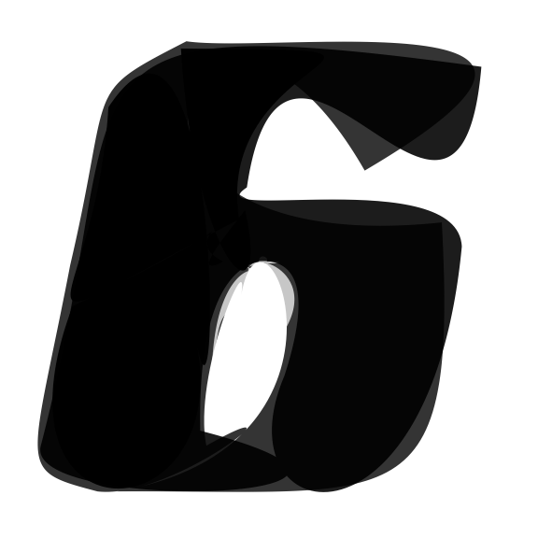





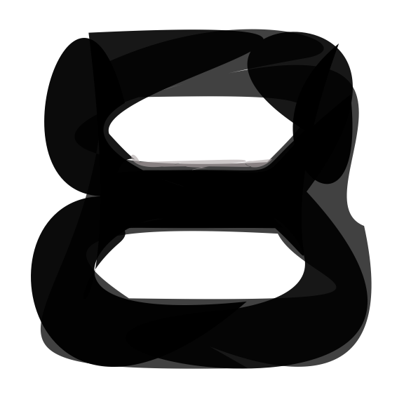
Input
ImageVAE
SVG-VAE
DeepSVG
Im2Vec
Ours

Slide 16




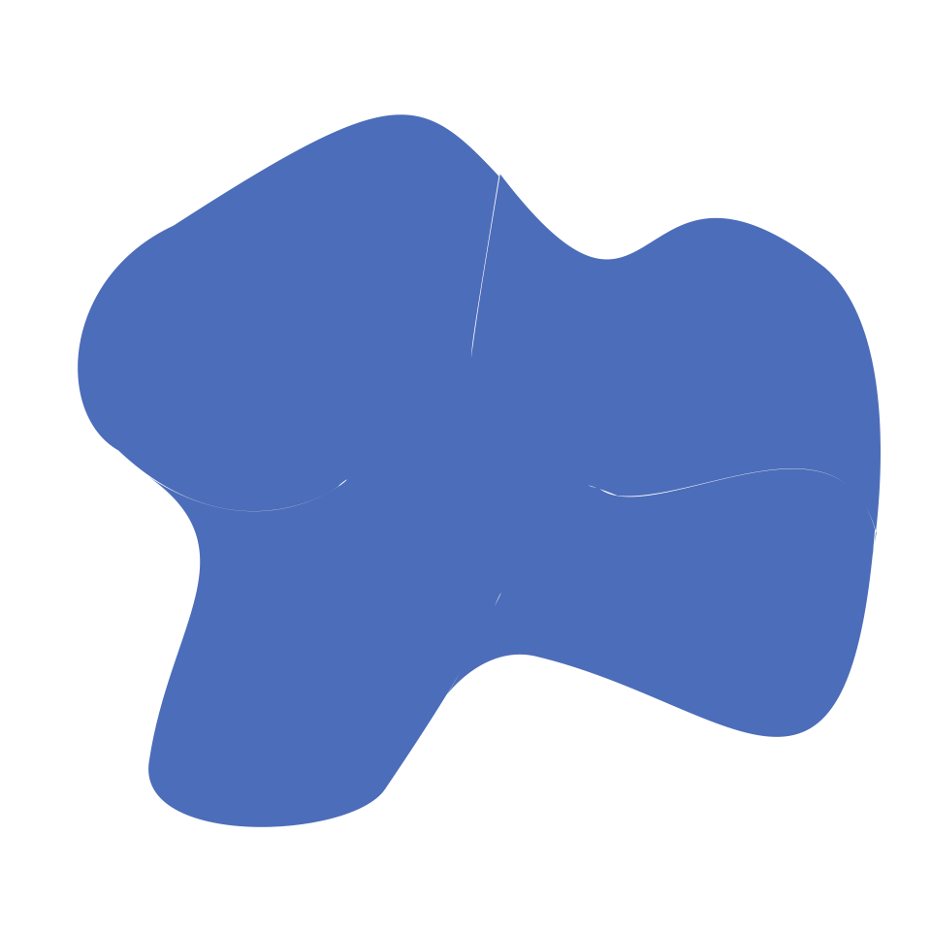

Input
Seg4
Seg8
Seg12
Seg16
Seg20

Slide 17

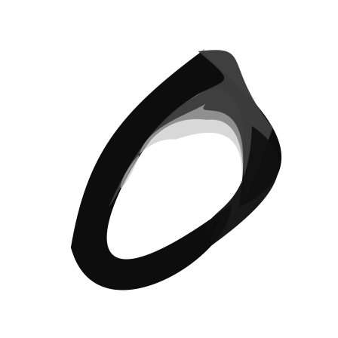
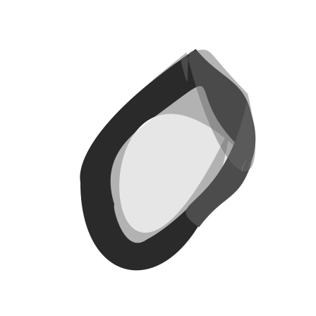
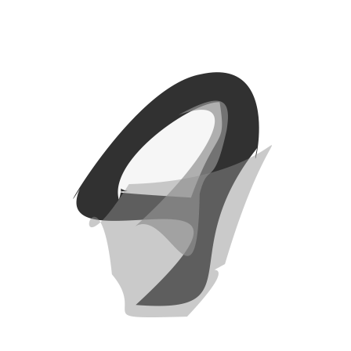
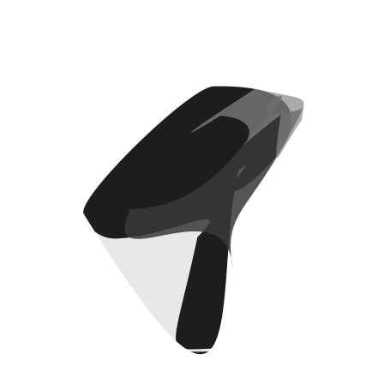
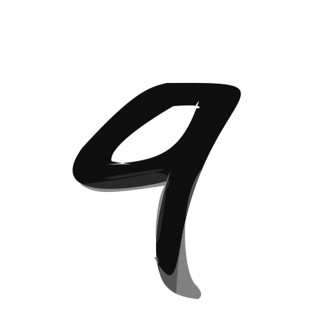
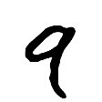
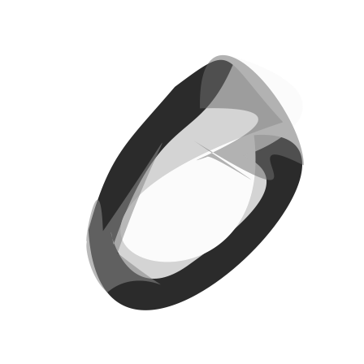
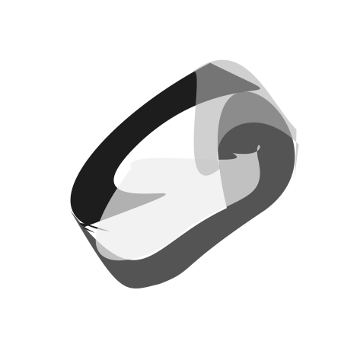


4
6
8
2

Slide 18














1 3 5 7 9
4
6
8
2

Slide 19







1
8
16
4
32
64
128

Slide 20



































DiffVG
Target
Painter
LIVE
N=1
N=4
N=8
N=16
N=32
N=64
DiffVG
Target
Painter
LIVE
N=32
N=64
N=128
N=256
N=512

Slide 21
Without Xing Loss
With Xing Loss (1e-2)

Slide 22







Slide 23













Slide 24












Slide 25



Slide 26



Slide 27



Slide 28



Slide 29



Slide 30



Slide 31



Slide 32



Slide 33



Slide 34



Slide 35



Slide 36



Slide 37

$\left[\begin{matrix}1 & 2 \\ 3 & 4 \\ 5 & 6\end{matrix}\right]→$ $\left[\begin{matrix}5 & 6 \\ 3 & 4 \\ 1 & 2\end{matrix}\right]$

Slide 39




Slide 40




































Input
Layer-wise Image Vectorization (from left to right)

Slide 41




X-ing Loss to avoid self-intersection
B
B
$$θ$$
C
$$θ$$
C
$$\sin{θ}$$
$$D_{1}= 𝕝(\frac{\vec{AB}× \vec{BC}}{\left\|\vec{AB}\right\|\left\|\vec{BC}\right\|}≥0)$$
$$D_{2}= \frac{\vec{AB}× \vec{CD}}{\left\|\vec{AB}\right\|\left\|\vec{CD}\right\|}$$
A
D
A
$$ℒ=D_{1}\left(ReLU\left(−D2\right)\right)+(1−D1)(ReLU\left(D2\right))$$
D

Slide 42




Results Comparison on our dataset
Without Xing Loss
With Xing Loss (1e-2)
Without Xing Loss
With Xing Loss (1e-2)

Slide 43


Failure Cases
It follows the rules defined by the loss, but self-intersection still exist.
We need a stricter loss to constrain each segments to avoid (returning back lines)
Under the strict loss, more segments begin to help

Slide 44

Stricker?
B
B
$$θ$$
C
$$θ$$
C
A
D
A
Only allow 90 $θ$ degree segments (using sqrt function to constrain the loss range)
D

Slide 45






Stricker Xing Loss?
Without Xing Loss (1e-2)
Without Xing Loss v1
Without Xing Loss v2

Slide 46




Still some problems here…

Slide 47




















Input
Im2Vec
DiffVG
ours

Slide 48



















DiffVG
Painter
Raster Input
LIVE
N=4
N=16
N=32
N=64
N=196
DiffVG
Painter
Raster Input
LIVE
N=32
N=64
N=128
N=256
N=512

Slide 49


















































Slide 50


























N=4
N=20
N=4
N=20
N=4
N=20
Input
Im2Vec
DiffVG
LIVE

Slide 51










DiffVG
Painter
LIVE
N=10
N=20
N=30
N=40
N=50

Slide 52










DiffVG
Painter
LIVE
N=32
N=64
N=128
N=256
N=512

Slide 62
A | B
B | C
A | B | C | D | E
C | D
D | E
E | A

